Slide 1
Truncation of IFT80 causes early embryonic loss in cattle
John B. Cole,^{1,2,*} Derek M. Bickhart,³ Kelsey N. Clark,⁴ Jana L. Hutchison,³ Jennifer C. McClure,² Daniel J. Null,³ and M. Sofía Ortega⁴
¹Animal Genomics and Improvement Laboratory, ARS, USDA, Beltsville, MD
²URUS Group LP, Madison, WI
³Cell Wall Biology and Utilization Research Laboratory, U.S. Dairy Forage Research Center, ARS, USDA, Madison, WI
⁴Division of Animal Sciences, College of Agriculture, Food, & Natural Resources, University of Missouri, Columbia, MO
john.cole@urus.org

Slide 2

Genetic diseases are common
There currently are 608 genetic traits/disorders of cattle in the Online Mendelian Inheritance in Animals database
https://omia.org/home/
286 of these are Mendelian traits/disorders

Slide 3
This not a dairy-specific problem!
Beef cattle
Jenko et al. (2019; PMID: 30836944) reported 1 new lethal and 2 new semi-lethal haplotypes
Poultry
Youngworth and Delany (2019; PMID: 31075853) identified the causal variant for the Wingless-2 developmental syndrome
Pigs
Derks et al. (2019; PMID: 30875370) found 5 relatively common recessive lethal haplotypes in 2 commercial populations

Slide 4
How are haplotypes affecting fertility detected?
Lethal haplotypes are blocks that never appear as homozygotes even though a substantial number are expected
Fertility data used to determine if carrier × carrier matings have reduced fertility
Identifies recessives with effects early in gestation
Dystocia data can be used to check for effects on stillbirth rates
Identifies recessives with effects late in gestations
Methodology described in VanRaden et al. (2011; PMID: 22118103)

Slide 5
Effects confirmed using fertility data
Carrier-to- carrier matings are tested for effects on conception rate and stillbirth
Early embryonic losses show conception rate effects (e.g., HH2 and JH1)
Some variants show stillbirth effects (e.g., BH2 and HCD)
For example, matings of AH1 carrier sires to cows with AH1 carrier maternal grandsires had 6.1% lower sire conception rate
Bioinformatics used to identify putative causal variants

Slide 6
Known recessive defects in U.S. Holsteins
Haplo- type | Functional/Gene name | BTA chromosome | Location (Mbp) | Haplotype frequency (%) | Timing¹
HBR | Black/red coat color/MC1R(MSHR) | 18 | 14.8 | 0.75 | —
HCD | Cholesterol deficiency/APOB | 11 | 78.0 | 2.28 | W
HDR | Dominant red color/MC1R(MSHR) | 3 | 9.5 | 0.03 | —
HH0 | Brachyspina/FANCI | 21 | 21.2 | 1.65 | E,B
HH1 | APAF1 | 5 | 63.2 | 1.28 | E
HH2 | IFT80 | 1 | 94.9 – 96.6 | 1.21 | E
HH3 | SMC2 | 8 | 95.4 | 2.64 | E
HH4 | GART | 1 | 1.3 | 0.23 | E
HH5 | TFB1M | 9 | 93.2 – 93.4 | 2.39 | E
HH6 | SDE2 | 16 | 29.0–29.1 | 0.44 | W
HHB | BLAD/ITGB2 | 1 | 145.1 | 0.21 | W
HHC | CVM/SLC35A3 | 3 | 43.4 | 1.10 | E,B
HHD | DUMPS/UMPS | 1 | 69.8 | 0.01 | E
HHM | Mule foot/LRP4 | 15 | 77.7 | 0.05 | B
HHP | Polledness (dominant)/POLLED | 1 | 1.7 – 2.0 | 0.88 | —
HHR | Red coat color/MC1R(MSHR) | 18 | 14.8 | 3.29 | —
¹Timing of embryonic loss/calf death for homozygous animals: B = calf death at/shortly after birth,
E = embryonic loss/abortion, W = calf death weeks/months after birth (Cole et al., 2018; https://bit.ly/2utjPbT).

Slide 7
Estimated cost of genetic load
Cole et al. (2016; PMID: 27394947) estimated annual losses of at least $10.7 million due to known recessives.
Average losses were $5.77, $3.65, $0.94, and $2.96 in Ayrshire, Brown Swiss, Holstein, and Jersey, respectively.
This is the economic impact of genetic load as it affects fertility and perinatal mortality.
Actual losses are likely to be higher.

Slide 8
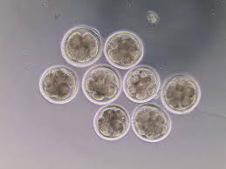
Validation of candidate variants
Candidate genes for early embryonic losses not always validated in the laboratory
Targeted knockouts can be used to validate candidates for early embryonic losses
Relatively fast and cost-effective
Source: University of Florida (2013).

Slide 9
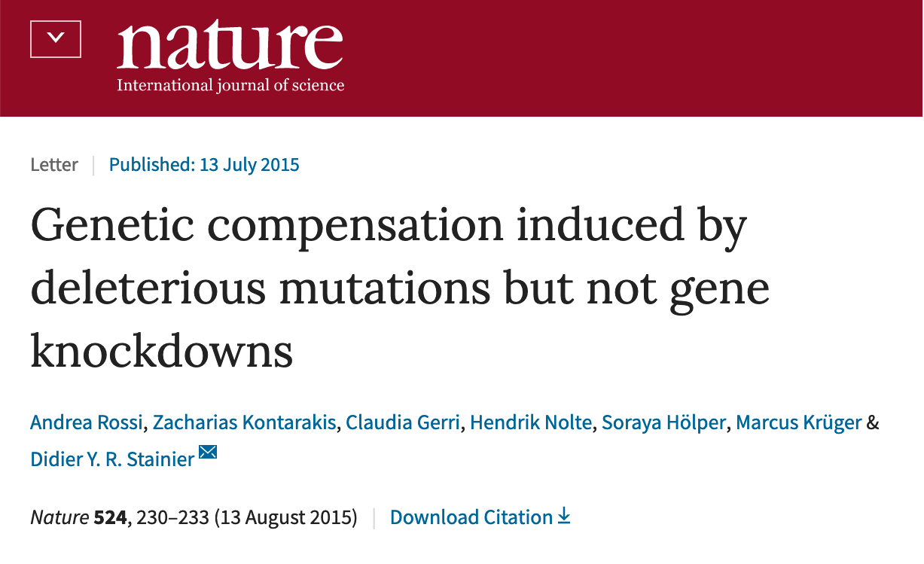
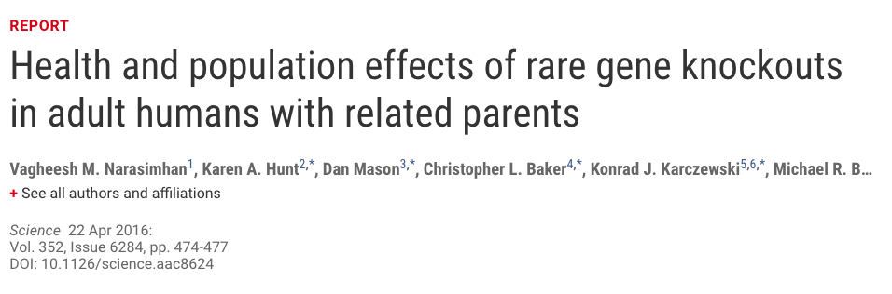
Why is functional validation desirable?
Not all mutations produce phenotypic change
Compensatory networks can buffer against deleterious mutations (Rossi et al., 2015; PMID: 26168398)
Many homozygous loss-of-function alleles produce no deleterious phenotypes, including some expected to result in genetic disease (Narasimhan et al., 2016; PMID: 26940866)

Slide 10
Identification of candidate HH2 variant
HH2 identified from a deficiency-of-homozygotes approach and undesirable effects on conception rate and stillbirths confirmed
5 carriers were present in a group of 183 sequenced Holstein bulls selected to maximize the coverage of unique haplotypes
3 variants concordant with the haplotype calls were found in the HH2 region
A high-impact frameshift in intraflagellar protein 80 (IFT80) was confirmed in Holsteins from the 1000 Bull Genomes Project that shared no animals with the discovery set

Slide 11
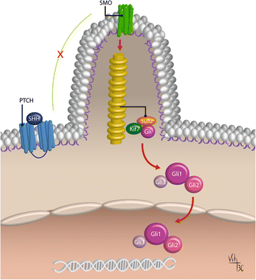
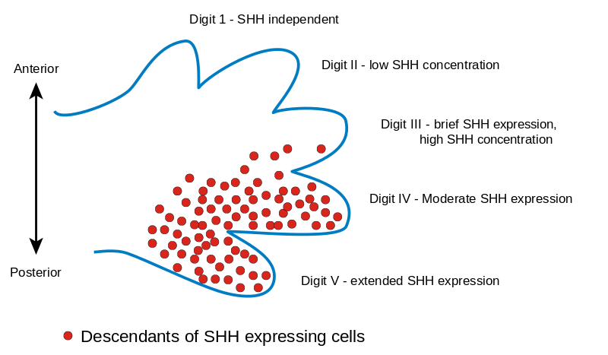
What does IFT80 do in the cell?
Source: https://en.wikipedia.org/wiki/File:Limb_bud.svg.
One thing sonic hedgehog does is specify digit identity in mammalian development.
Source: Cafballo et al. (2018; PMID: 29558958).

Slide 12
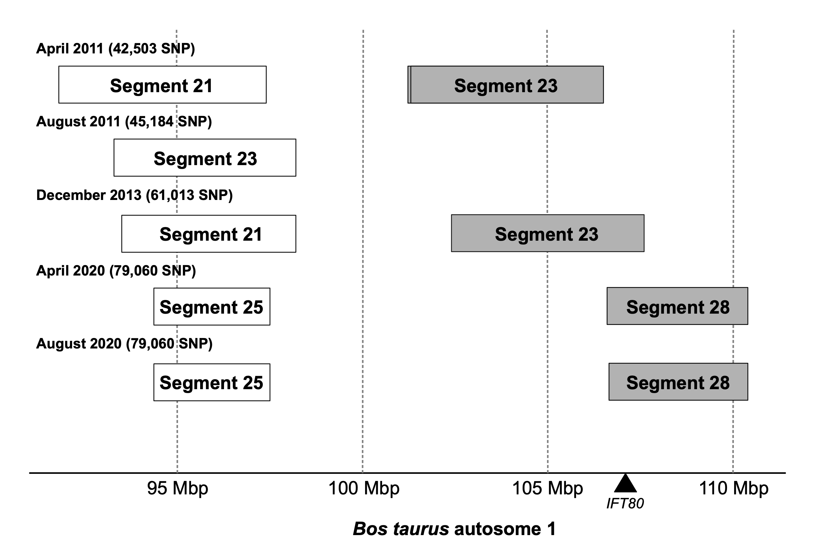
Refinement of HH2 haplotype

Slide 13
“The same families that had haplotype 21.337 also had nearby segment 23.51 with the same inheritance pattern, number of expected homozygotes, and effects on conception rate and stillbirth as found for 21.337. Thus, the map location of 21.337 is indicated in Table 1, but a longer region of 15 Mbp might contain the defect because a large chromosomal segment remained intact.” – VanRaden et al. (2011; PMID: 22118103)

Slide 14
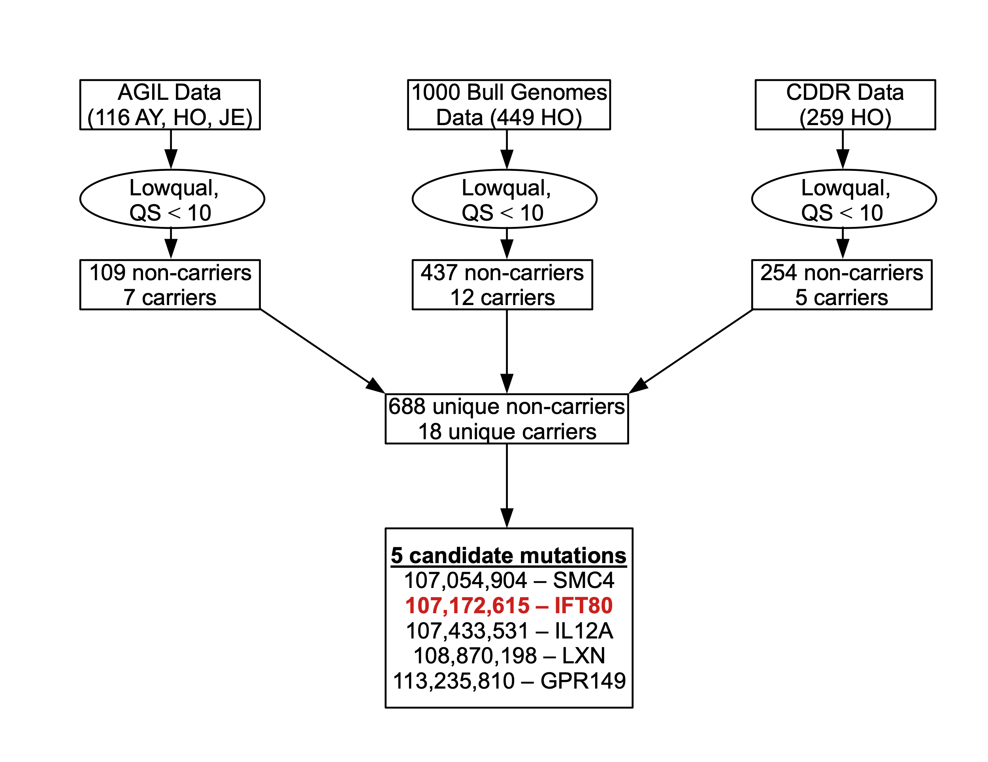
Sources of data used for bioinformatics analysis

Slide 15
Validation of candidate HH2 variant
IFT80-null embryos generated by truncation at exon 2 with guide-RNAs annealed to Cas9 mRNA
Abattoir-derived oocytes fertilized in vitro with high-fertility semen
Embryos injected at the one-cell stage with CRISPR-Cas9 complex (treatment) or Cas9 mRNA (control) before return to culture
IFT80-null embryos arrested at the 8-cell stage of development, consistent with data from mouse hypomorphs and HH2 carrier-to-carrier matings

Slide 16
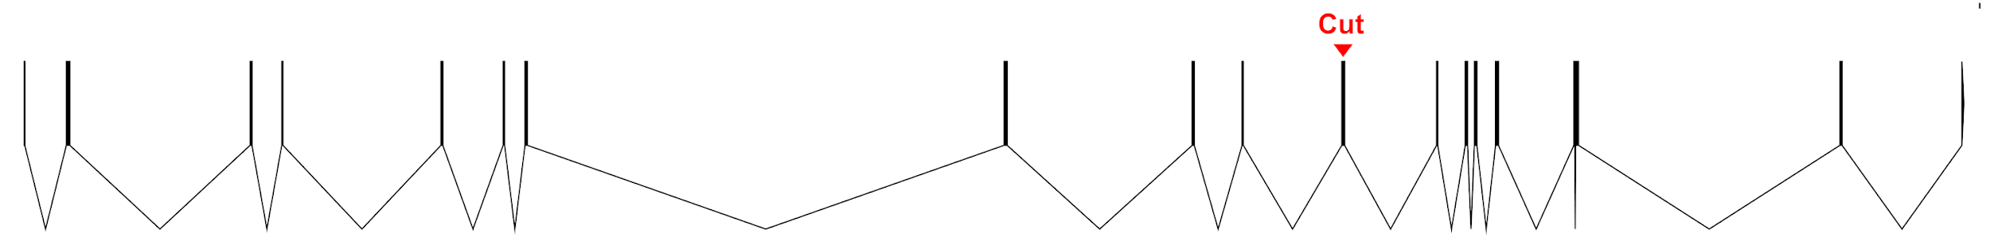
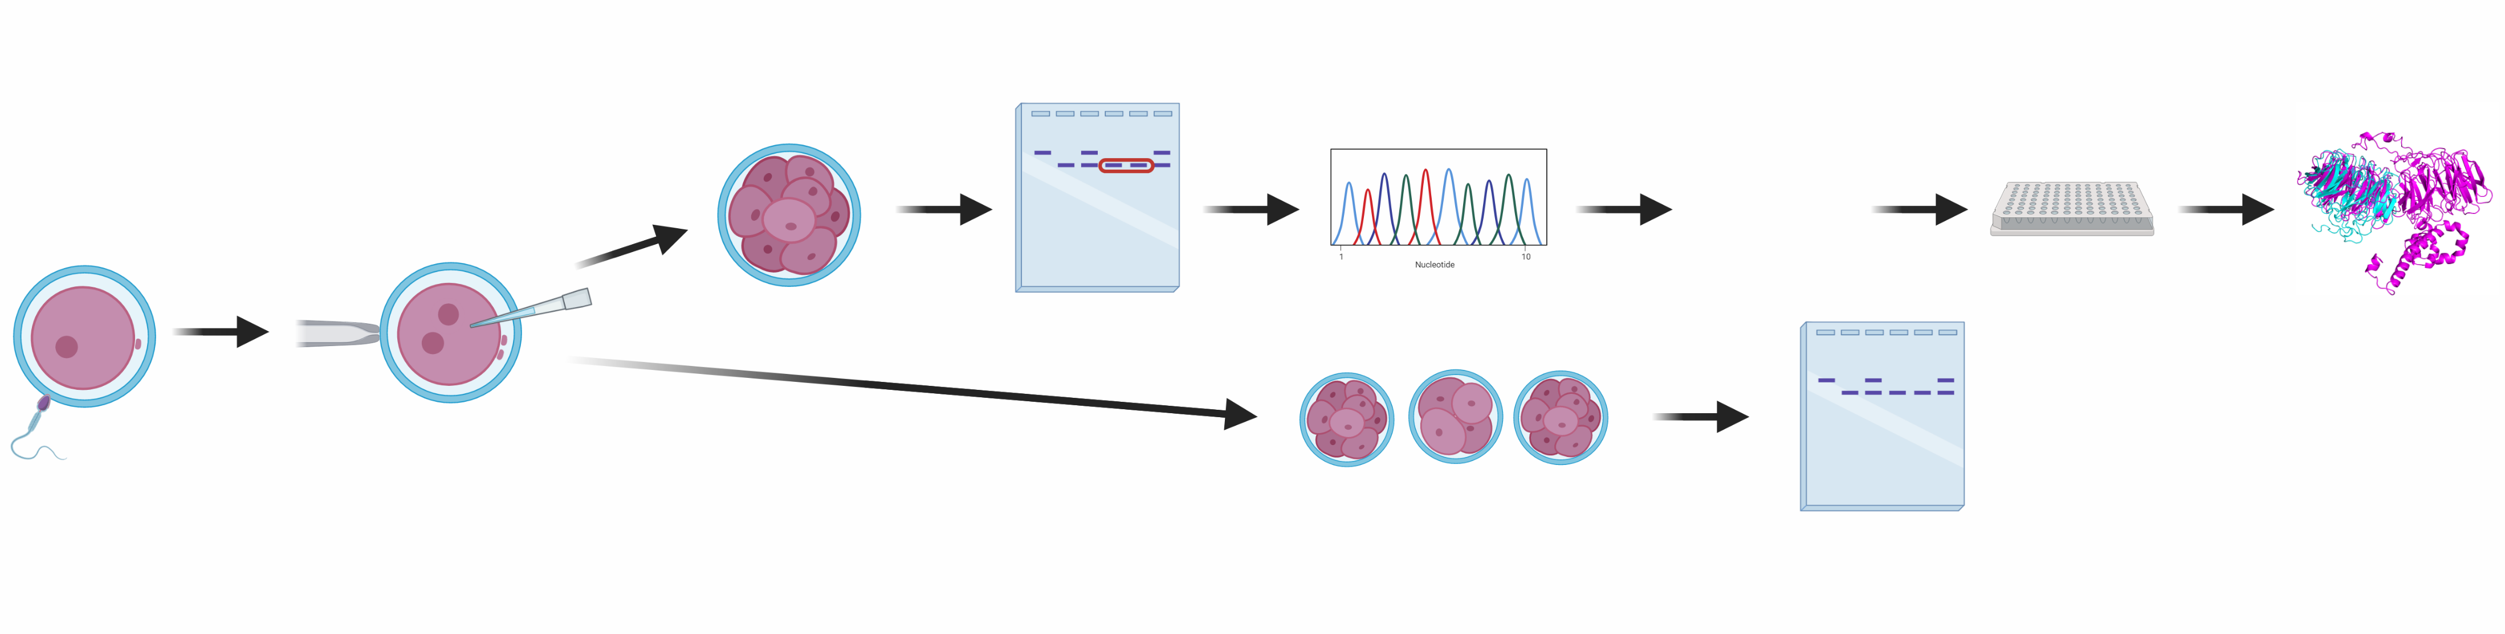
Overview of gene editing experiments
Exon 11
IFT80 is first expressed at the 8-cell stage (Graf et al., 2014)
CRISPR-Cas9 Guides:
317 nt cut
2.5
2
1.5
Mutation site
Relative Expression
1
0.5
Experimental Design:
Sanger
Sequencing
0
Blastocyst
8-cell
Genotype
Day 3
Investigate
biallelic
embryos
n = 100
Real-time PCR
Predict protein structure
n = 150
Day 8
50 ng/µl Guide 1
50 ng/µl Guide 2
40 ng/µl Cas9
Embryos were collected either on day 3 or 8
Record developmental rates Collect embryos
Genotype
n = 50
To be rigorous, only biallelic edits were considered as knockouts.
Notes:
To test the hypothesis we used a crispr-cas9 system
Used 2 guides to create Large enough cut that we can easily genotype in the lab
IFT80 is first expressed at the 8-cell stage (graf) and we corroborated that in our lab
Zygotes microinjected at these concentrations of the guide cas9 complexes
Genotype by amplifying the edited region of the gene
Sanger seq to corroberate
Only used biallelic to have same phenotype
Real time pcr in different areas of the transcript to make sure function is lost
Genotype to correlate ift80 edit to developmental data
gRNAs annealed to a tracr-Cas9mRNA complex

Slide 17
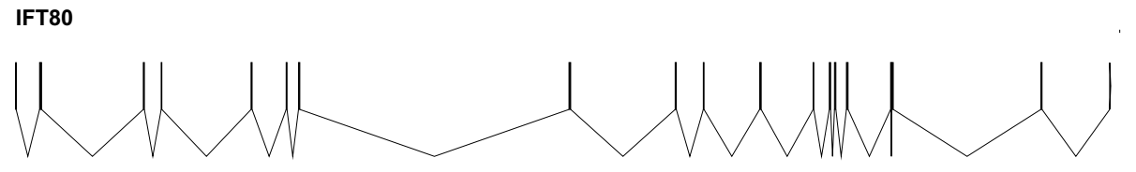
Experiment 1: Exon 2
1
2
3
4
5
6
7
8
9
10
11
12
15
16
18
19
Guides target Exon 2
2 set of primers were designed to target these exons so that the gene is disrupted enough to block transcription (also why both primer sets are intron spanning)

Slide 18
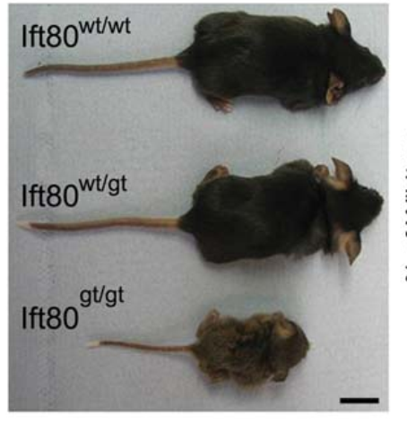
Is IFT80 expressed in the bovine embryo?
Expression relative to the blastocyst
3 pools of 5 embryos at each stage, 2 housekeeping genes.
Yuan et al. (2016, PMID: 26996322)

Slide 19
Survival of embryos to the 16-cell stage

Slide 20
Gene expression of IFT80-null embryos
Only embryos with successful bi-allelic edits were used.
Groups of 4 embryos were pooled for PCR, resulting in 3 pools of biallelic-edited embryos (IFT80-null) and 3 pools of wild-type embryos (injected only with CAS9 mRNA).

Slide 21
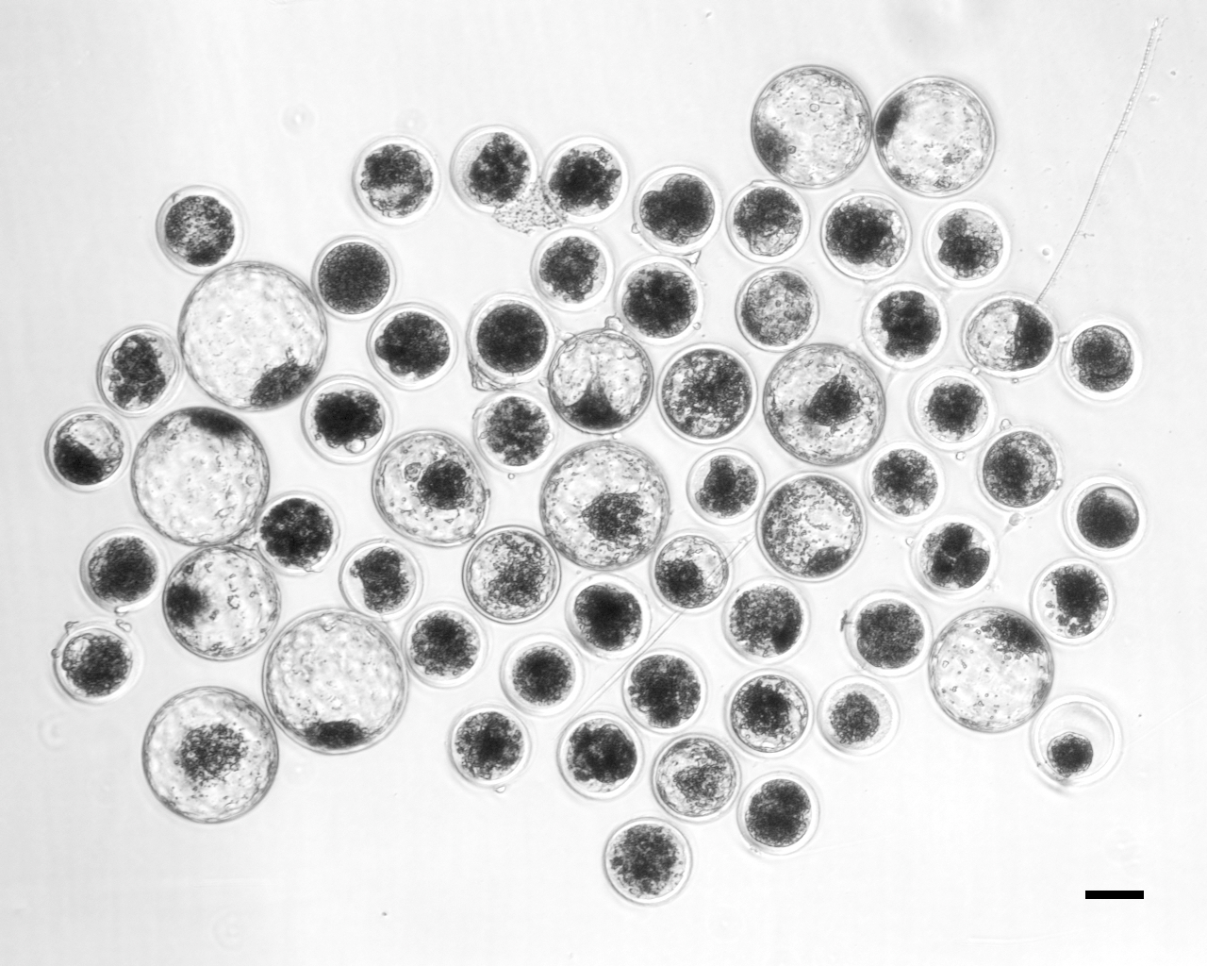
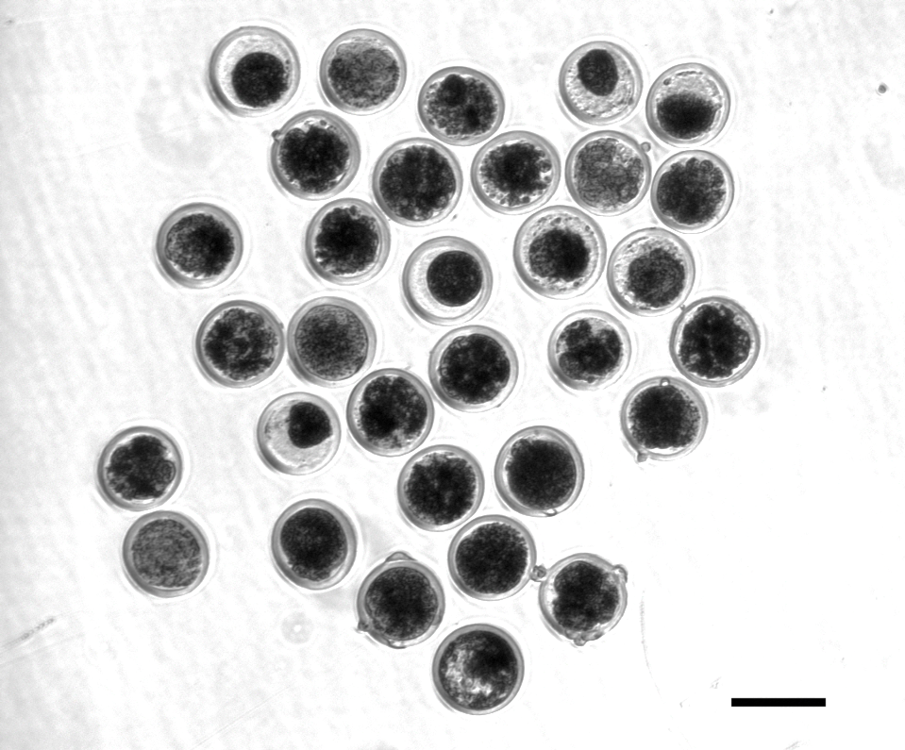
Roll that beautiful blastocyst footage!
Control embryos injected with only Cas-9 RNA.
Treatment embryos injected with Cas-9 and IFT80 exon 2 guide RNA.

Slide 22
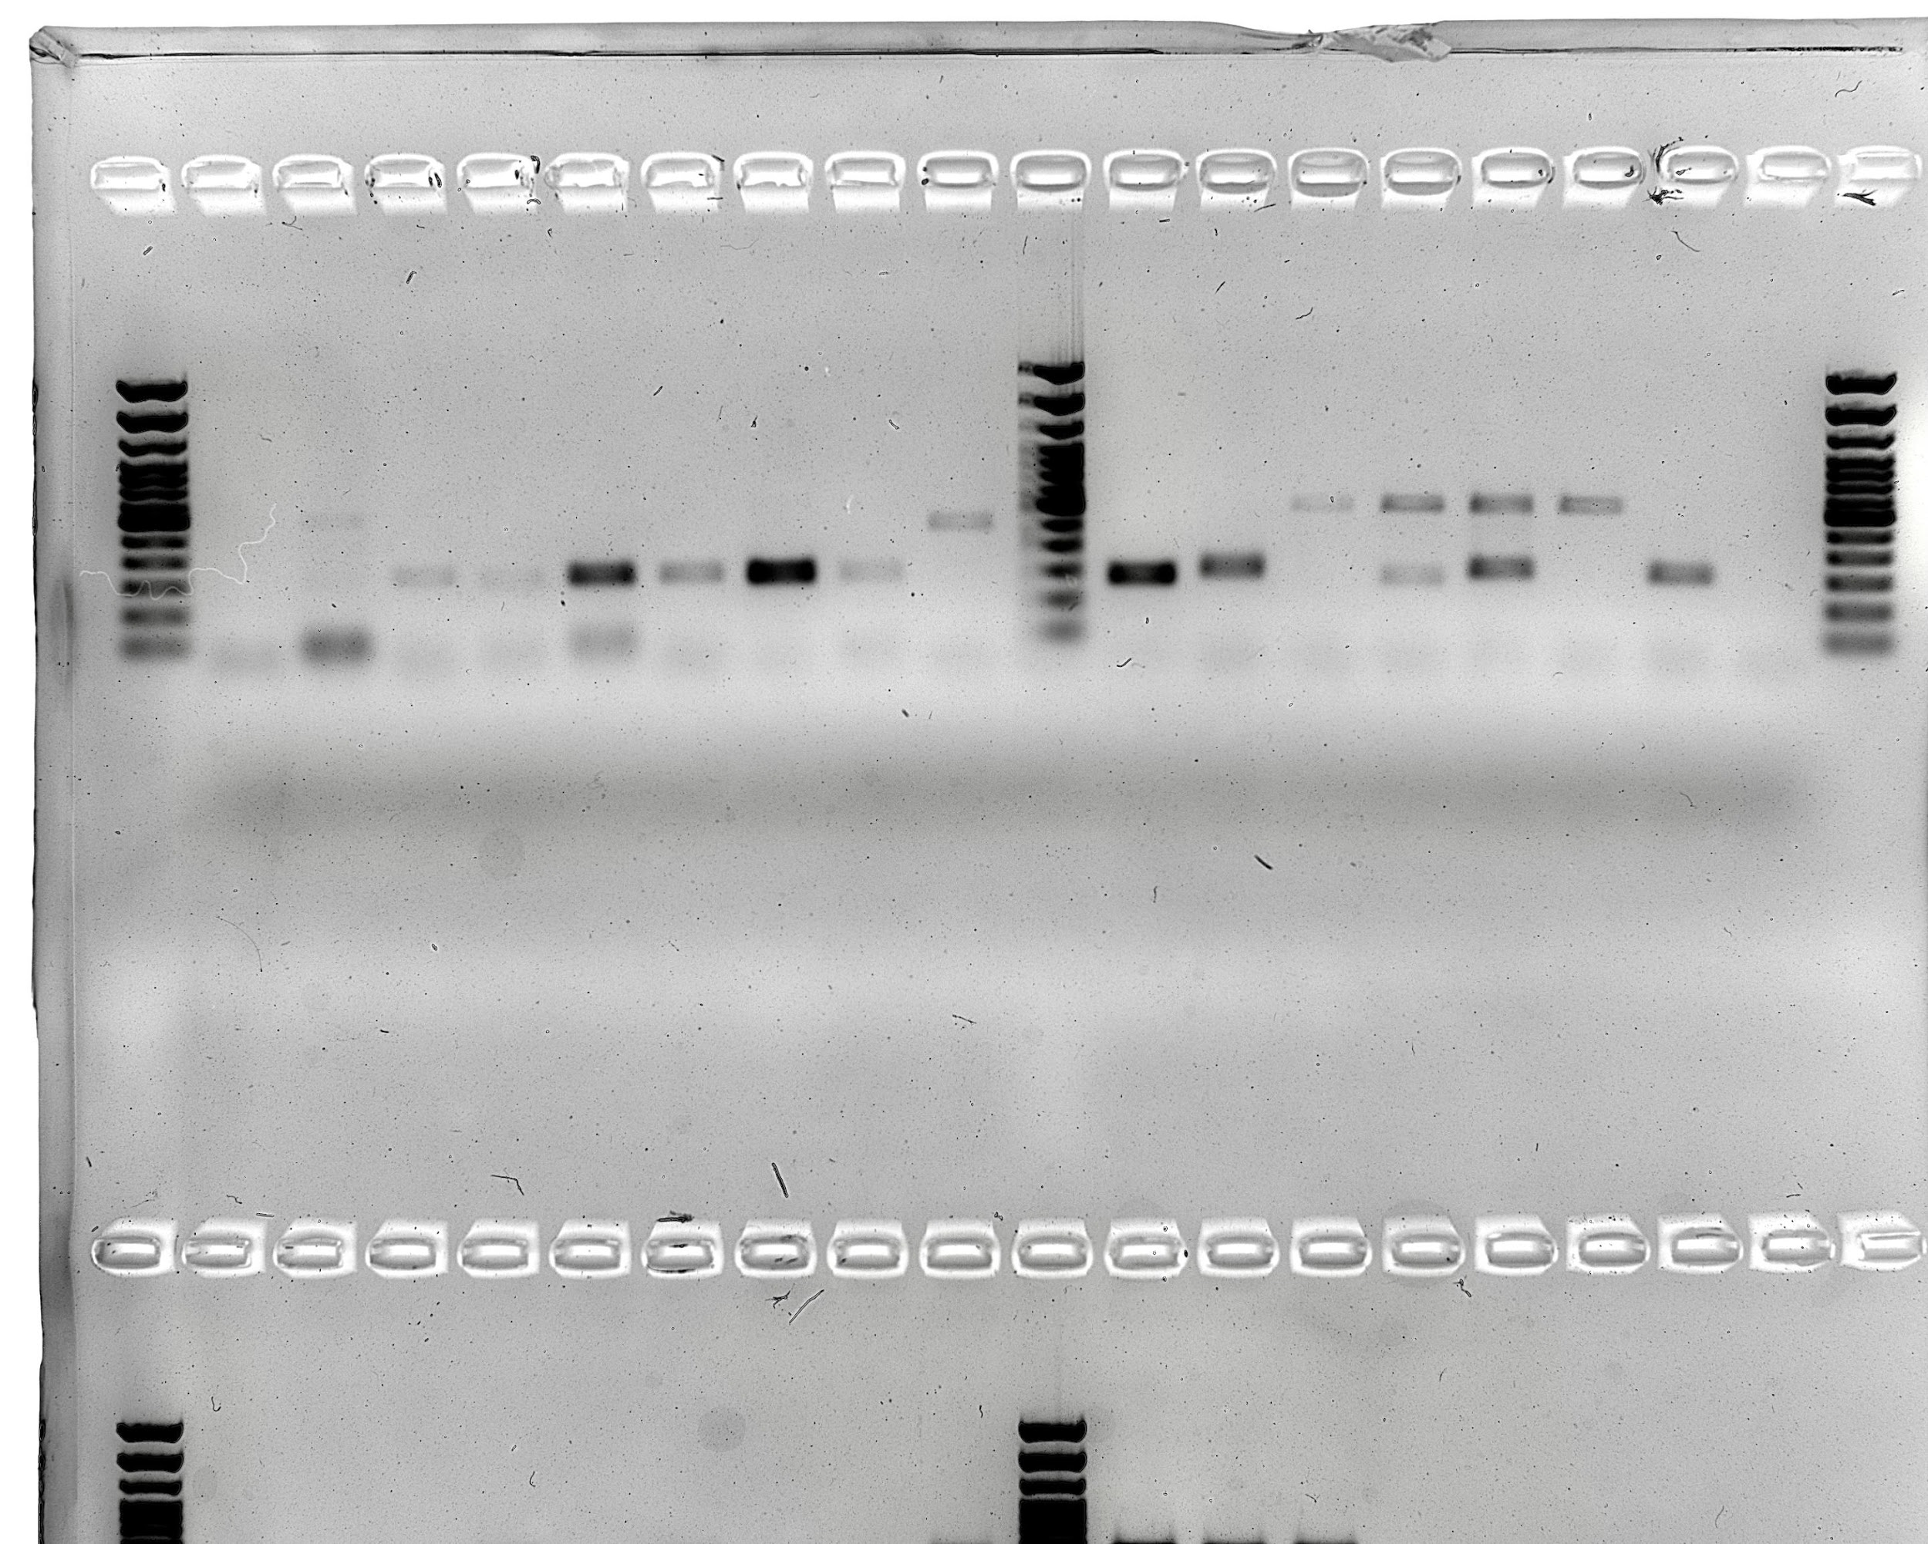
Editing efficiency for IFT80 exon 2
Wild
Type
Biallelic

Slide 23
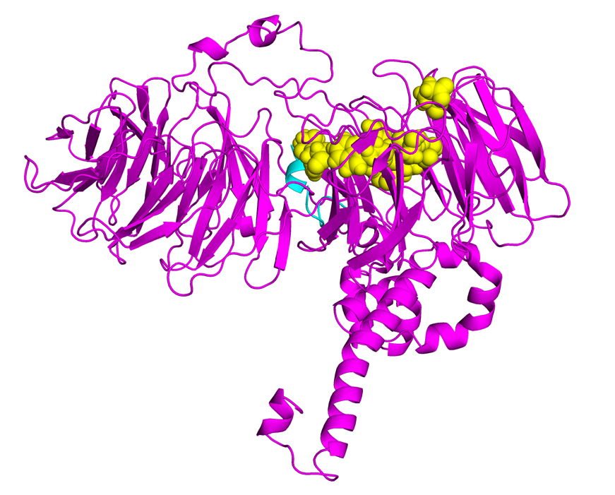
Protein structure for IFT80 exon 2 edit
Wild-type is 777 amino acids (pink)
Exon 2 cut is 18 amino acids (blue)
MRLKISLLKEPKHQELVS

Slide 24
What have we learned from this?
Disruption of the entire gene product results in arrested embryo development.
This implies that the IFT80 gene product is required for the normal development of the bovine embryo.
It also suggests that mutations in IFT80 are not compensated for by other buffering mechanisms in the hedgehog signaling pathway.

Slide 25
Experiment 2: Exon 11
1
2
3
4
5
6
7
8
9
10
11
12
15
16
18
19
Guides target Exon 11

Slide 26
Survival of Exon 11 embryos to 16-cells

Slide 27
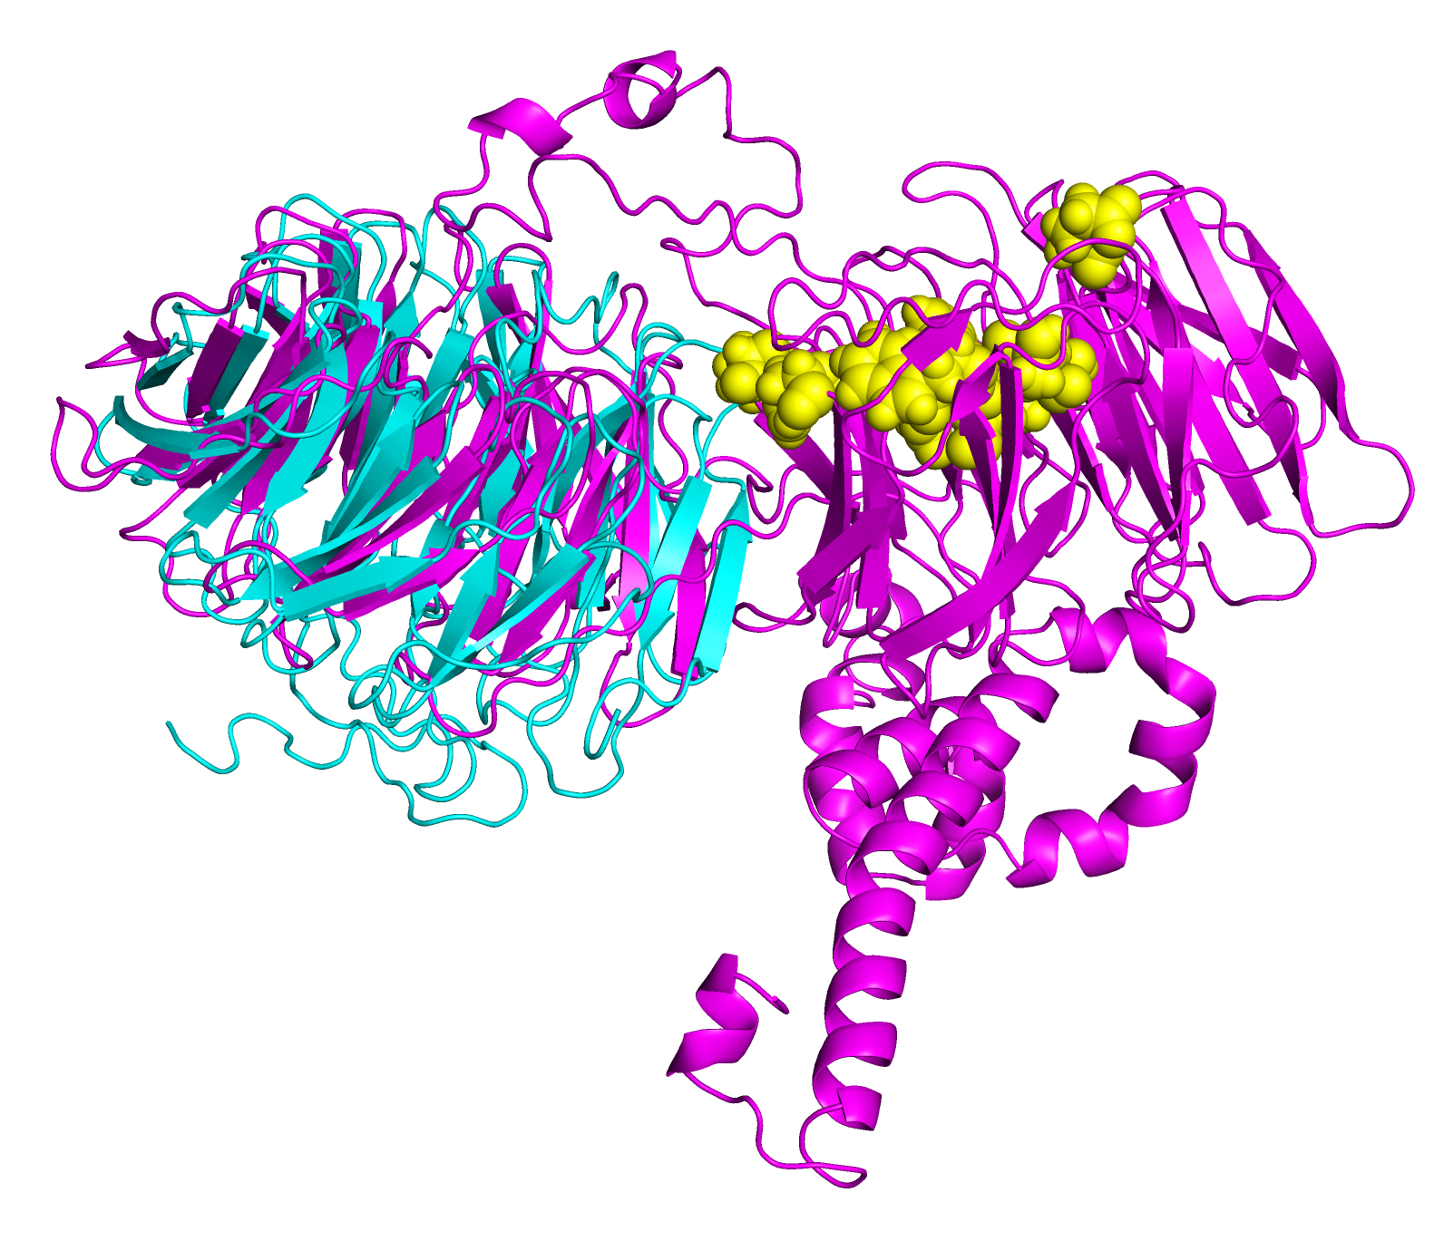
Protein structure for IFT80 exon 11 edit
Wild-type is 777 amino acids (pink)
Exon 11 cut is 385 amino acids (blue)

Slide 28
What does this add to our knowledge?
We already knew that disrupting the entire gene product arrested embryo development.
We learned that an edit which mirrors the in vivo mutation also prevents normal development.
This is strong evidence that the mutation identified in the IFT80 gene prevents embryonic development by disrupting hedgehog signaling in the early embryo.

Slide 29
What else could be done?
Haplotype carrier bulls could be genotyped with a custom assay to confirm that they carry the frameshift.
A tag SNP will be added to the net round of chips to track the causal instead of a haplotype.
Edited embryos could be implanted into recipient cows and pregnancy status monitored.
We could attempt to rescue the phenotype in knockout embryos.

Slide 30
Conclusions
Mendelian genetic disorders are responsible for economic losses to dairy farmers
As technology improves we are identifying more recessive defects
CRISPR-Cas9 knockouts can be used for functional validation of candidate mutations
A frameshift in IFT80 at 107,172,615 bp (p.Leu381fs) disrupts wnt and hedgehog signaling, and is responsible for the death of homozygous embryos
A tag SNP will be used to track the causal mutation

Slide 31
Acknowledgments
Mr. Kenneth Shallop, and Dr. Steve Schroeder of AGIL assisted with DNA extraction, sequencing, and alignment of resulting reads.
The Council on Dairy Cattle Breeding (Bowie, MD) provided access to the National Dairy Database for testing fertility effects and identifying candidate HH2 regions.
Access to SNP genotypes and DNA for sequencing was provided by the Collaborative Dairy DNA Repository (Verona, WI).
Data from Run 7 of the the 1000 Bull Genomes Project were used for independent validation of HH2.

Slide 32
Support
Bickhart: ARS project 5090-31000-026-00-D
Bickhart and Cole: AFRI Grant 2016-67015-24886
Cole, Hutchison, and Null: ARS project 8042-31000-002-00-D
Cole and Ortega: NIH and USDA-NIFA Dual-Purpose R01 Grant 4097656
USDA is an equal opportunity provider and employer. Mention of trade names or commercial products in this presentation is solely for the purpose of providing specific information and does not imply recommendation or endorsement by the US Department of Agriculture.

Slide 33
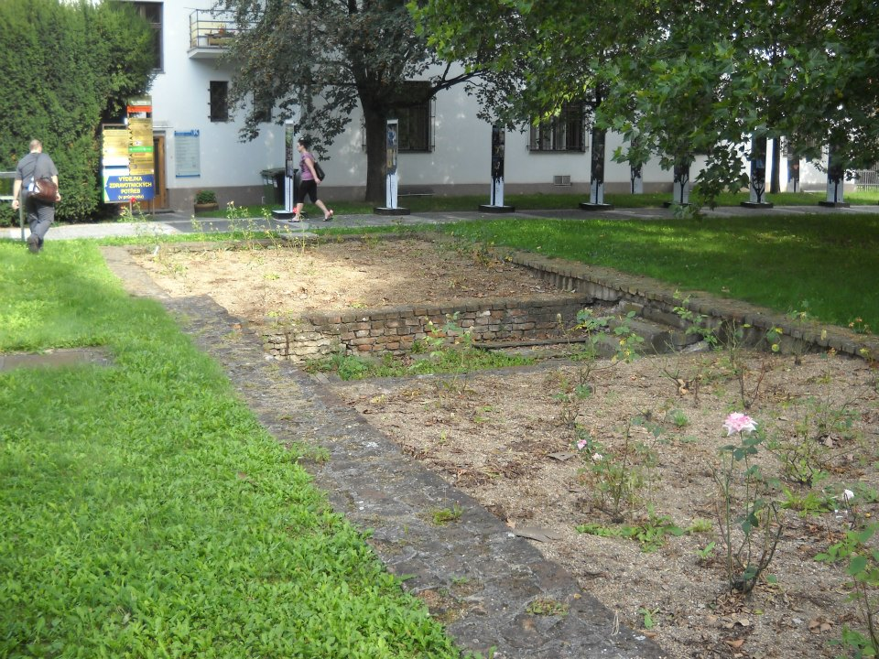
Questions?
Foundation of Gregor Mendel’s greenhouse, Brno, Czech Republic.

